Slide 1
Relationship in ER-Model
Dr. T. Joshva Devadas

Slide 2
Entity Set
Attributes and its types
Mapping Cardinality
Binary and Ternary relationship
Participation constraints
Structural constraints
Recursive relationship & role name
Weak entity set
ER diagram

Slide 3
Entity Set
An entity set is a set of entities of the same type that share the same properties, or attributes.
The set of all people who are instructors at a given university, for example, can be defined as the entity set instructor.
Similarly, the entity set student might represent the set of all students in the university.

Slide 4
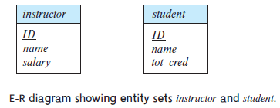
Attributes
An entity is represented by a set of attributes.
Attributes are descriptive properties possessed by each member of an entity set.
Each entity may have its own value for each attribute.
Possible attributes of the instructor entity set are
ID, name, dept name, and salary.

Slide 5
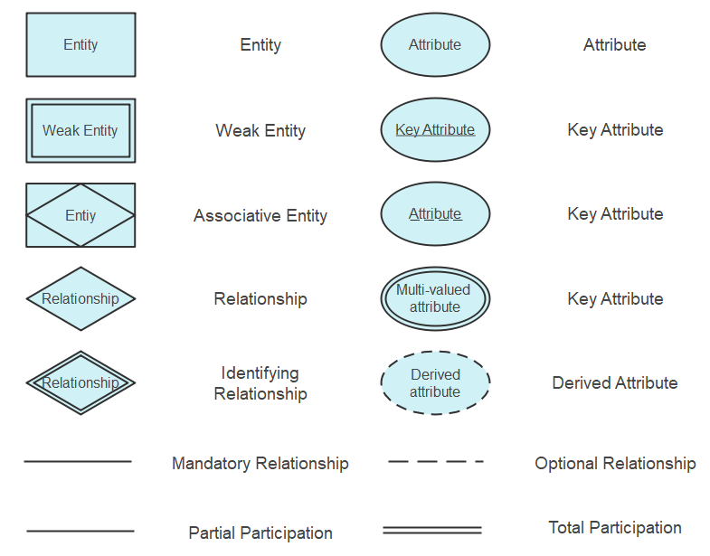
ER model Notations

Slide 6
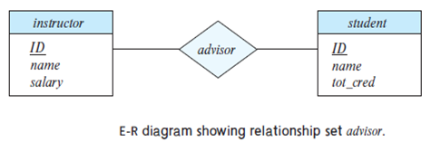
Relationship
A relationship is an association among several entities.
A relationship set is a set of relationships of the same type.
For example, we can define a relationship advisor that associates instructor Katz with student Shankar. This relationship specifies that Katz is an advisor to student Shankar.

Slide 7
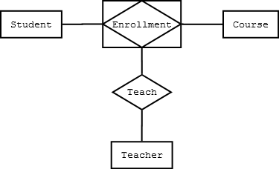
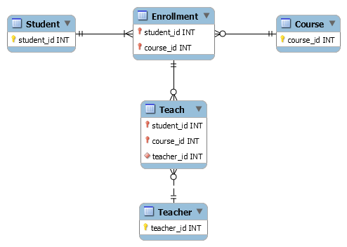
Associative Entities
Associative entities are used when you need a relationship to be involved in a relationship.
For a normal many-to-many relationship between Student and Course, we would use just a diamond. However, if we want to associate Enrollment with Teacher, we can turn Enrollment into an associative entity.
Physically the database looks like this

Slide 8
Relationship set
Formally, a relationship set is a mathematical relation on n ≥ 2 (possibly non distinct) entity sets.
If E1, E2,…, En are entity sets, then a relationship set R is a subset of
{(e1, e2,…, en) | e1 ∈ E1, e2 ∈ E2,…, en ∈ En}
where (e1, e2,…, en) is a relationship instance.
The association between entity sets is referred to as participation; i.e., the entity sets E1, E2,…, En participate in relationship set R.

Slide 9
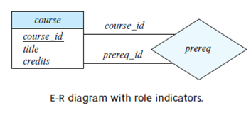
Role indicators

Slide 10
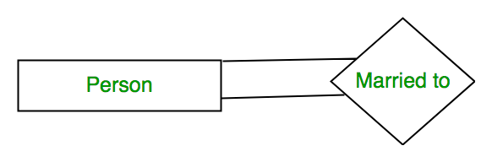
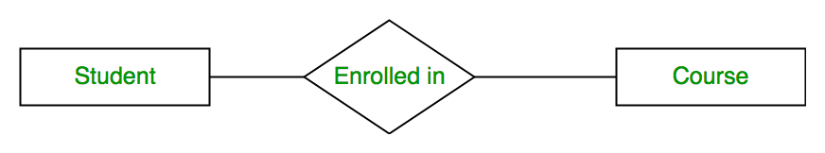
Degree of Relationship
Unary Relationship
Relationship among one entity set.
Binary Relationship
Relationship among two entities set.
Ternary Relationship
Relationship among 3 entities set.
N-ary Relationship :
Relationship between n number of entities set.
Teaches
Professor
Courses
Semester

Slide 11
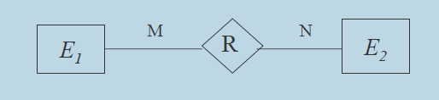
Binary Relationship and Cardinality ratio

Slide 12
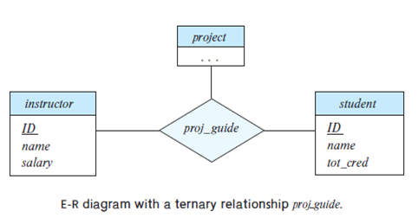
Ternary Relationship

Slide 13
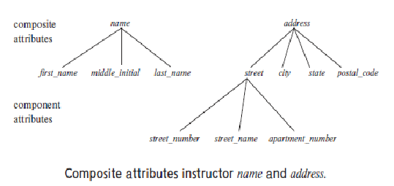
Types of Attributes
Simple attributes. the attributes have been simple; that is, they have not been divided into subparts.
Composite attributes, on the other hand, can be divided into subparts (i.e., other attributes).

Slide 14
Single-valued attributes : all have a single value for a particular entity. For instance, the student ID attribute for a specific student entity refers to only one student ID. Such attributes are said to be single valued.
Multivalued attributes :There may be instances where an attribute has a set of values or a specific entity. An entity set has a phone number attribute, the person may have zero, one, or several phone numbers, and different persons may have different numbers of phones. This type of attribute is said to be multivalued.
Another example is Dependents of an employee
Derived attributes : The value for this type of attribute can be derived from the values of other related attributes or entities.
For instance, let us say that the instructor entity set has an attribute students advised, which represents how many students an instructor advises. We can derive the value for this attribute by counting the number of student entities associated with that instructor.
As another example, suppose that the instructor entity set has an attribute age that indicates the instructor’s age. If the instructor entity set also has an attribute date of birth, we can calculate age from date of birth and the current date. Thus, age is a derived attribute. In this case, date of birth may be referred to as a base attribute, or a stored attribute. The value of a derived attribute is not stored but is computed when required.

Slide 15
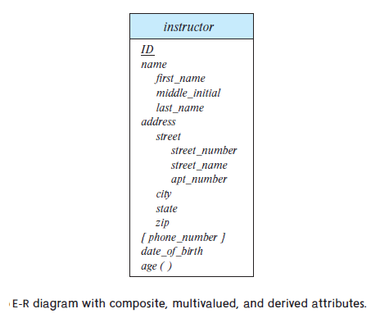

Slide 16
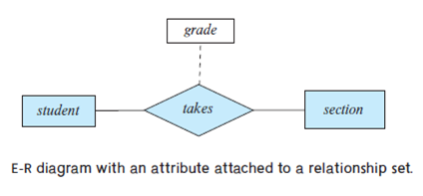
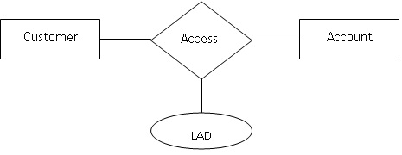
Descriptive attributes
A relationship may also have attributes called descriptive attributes.
In an Entity-Relationship (ER) model, descriptive attributes are properties or characteristics that further define the relationship between entities. They are not associated with individual entities themselves, but rather with the connection between them.
As an example of descriptive attributes for relationships, consider the relationship set takes which relates entity sets student and section.
We may wish to store a descriptive attribute grade with the relationship to record the grade that a student received in a course offering.

Slide 17
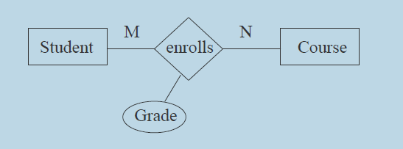

Attributes for relationship types
Properties of the association of entities

Slide 18
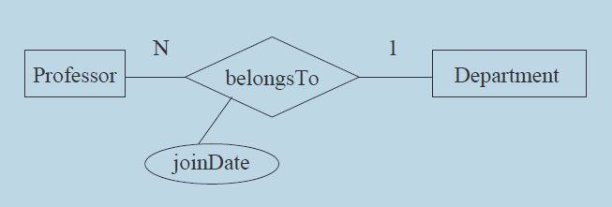
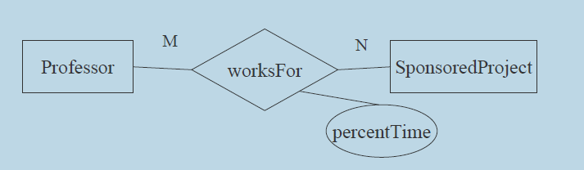
Attributes for relationship types-Examples

Slide 19
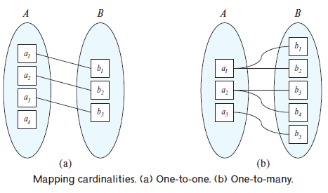
Mapping Cardinalities
One-to-one. An entity in A is associated with at most one entity in B, and an entity in B is associated with at most one entity in A.
One-to-many. An entity in A is associated with any number (zero or more) of entities in B. An entity in B, however, can be associated with at most one entity in A.

Slide 20
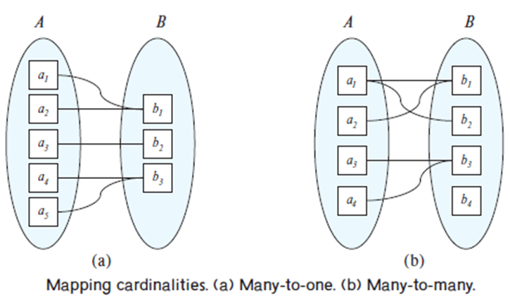
Many-to-one. An entity in A is associated with at most one entity in B. An entity in B, however, can be associated with any number (zero or more) of entities in A.
Many-to-many. An entity in A is associated with any number (zero or more) of entities in B, and an entity in B is associated with any number (zero or more) of entities in A.

Slide 21
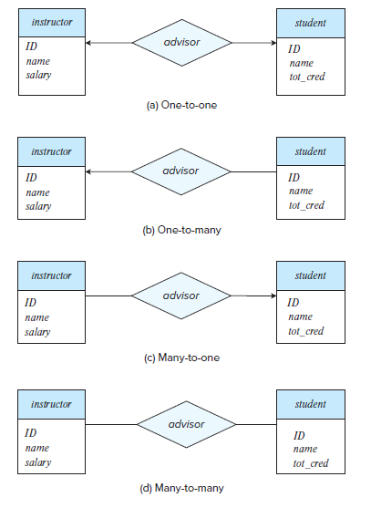
Relationship cardinalities
The directed lines to instructor and student indicate that an instructor may advise at most one student, and a student may have at most one advisor.
This indicates that an instructor may advise many students, but a student may haveat most one advisor.
This indicates that an instructor may advise at most one student, but a student may have many advisors.
This indicates that an instructor may advise many students, and a student may have many advisors

Slide 22
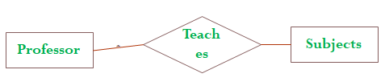

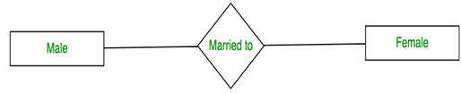

Mapping Cardinalities
Identify the mapping Cardinalities
One to One
One to Many
Many to Many
Many to One

Slide 23
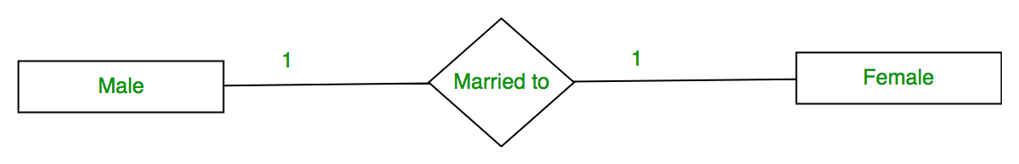
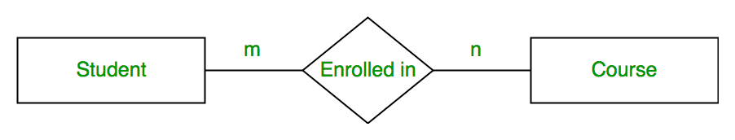
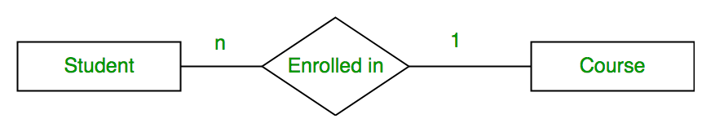
Mapping Cardinalities
Identify the mapping Cardinalities
One to One
One to Many
Many to Many
Many to One
1
Teaches
n
Subjects
Professor

Slide 24
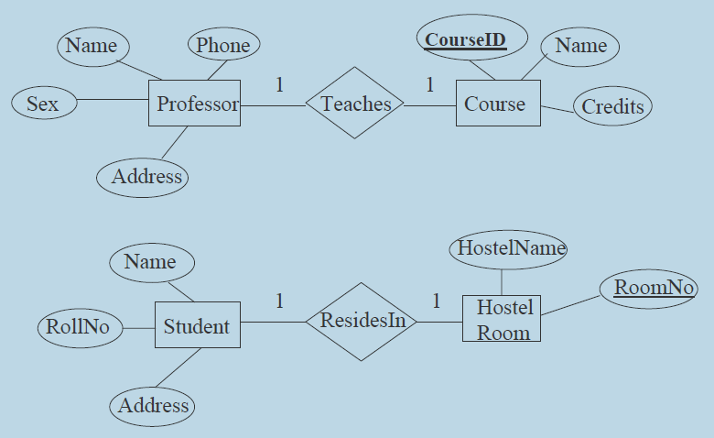
Binary Relationship and Cardinality ratio- Examples

Slide 25
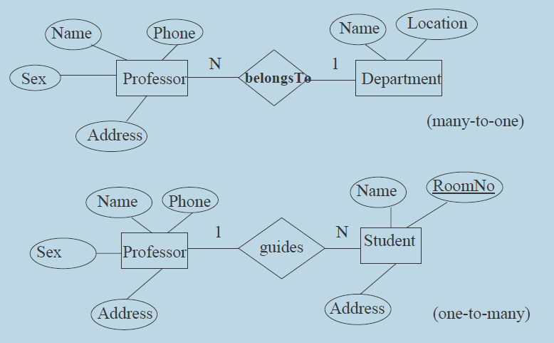
Binary Relationship and Cardinality ratio- Examples

Slide 26
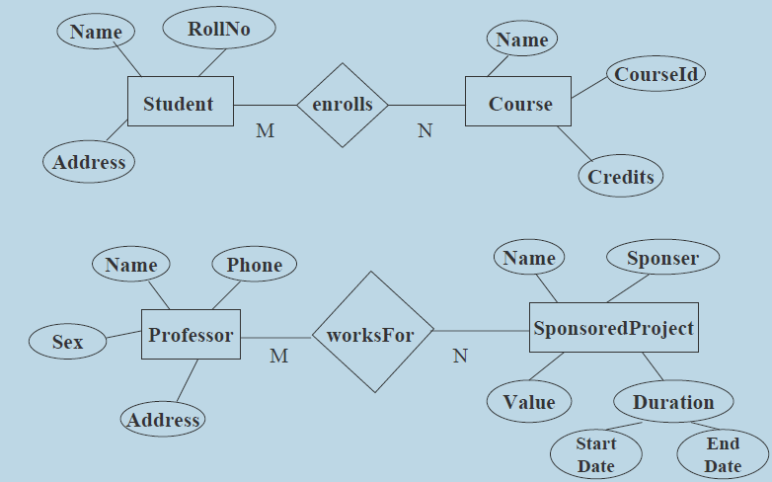
Binary Relationship and Cardinality ratio- Examples

Slide 27
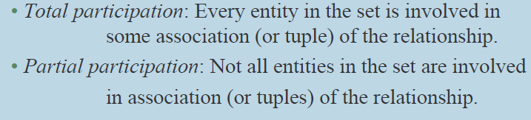
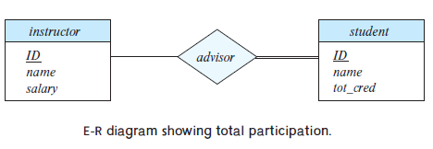
Participation constraints
An entity set may participate in a relation either totally or partially

Slide 28
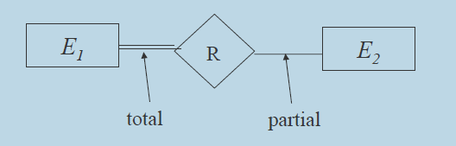
Participation constraints

Slide 29
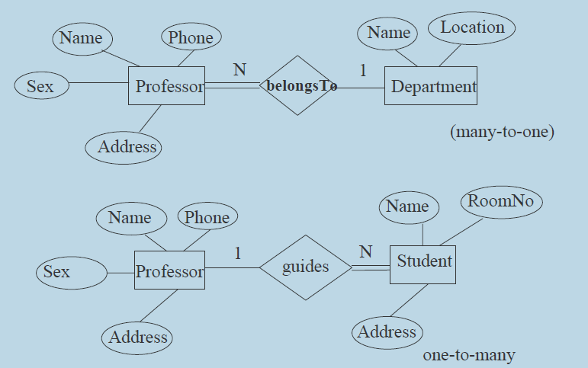
Participation constraints Examples

Slide 30


Structural Constraints

Slide 31
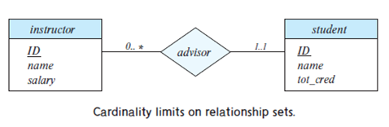
The line between advisor and student has a cardinality constraint of 1..1, meaning the minimum and the maximum cardinality are both 1. That is, each student must have exactly one advisor.
The limit 0.. ∗ on the line between instructor and student indicates that an instructor can have zero or more students.

Slide 32
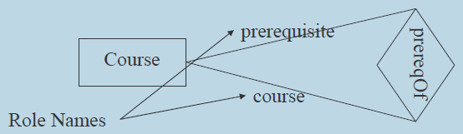
Recursive Relationship & Role Name
An entity set relating to itself.
Role name is used to specify the exact role in which the entity participate in the relationship

Slide 33
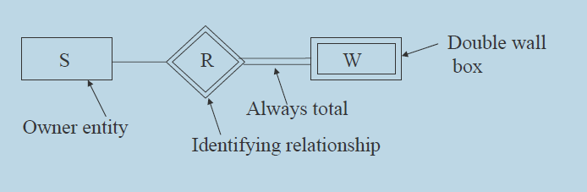
Weak Entity set
A weak entity set is one whose existence is dependent on another entity set, called its identifying entity set;
Instead of associating a primary key with a weak entity, we use the primary key of the identifying entity, along with extra attributes, called discriminator attributes to uniquely identify a weak entity.
An entity set that is not a weak entity set is termed a strong entity set

Slide 35
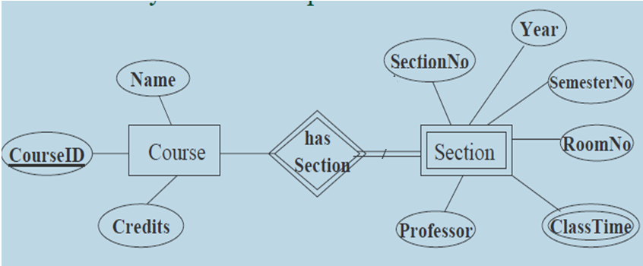
Weak Entity set

Slide 36
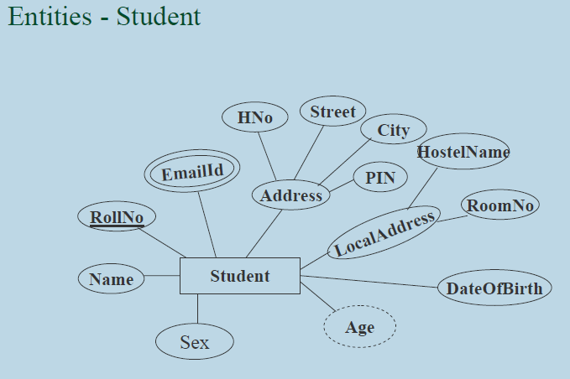
ER Diagram construction

Slide 37
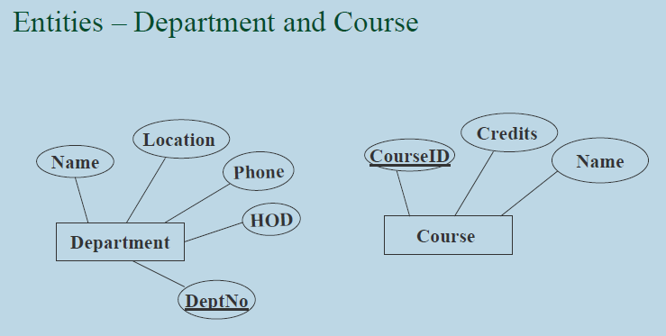
ER Diagram

Slide 38
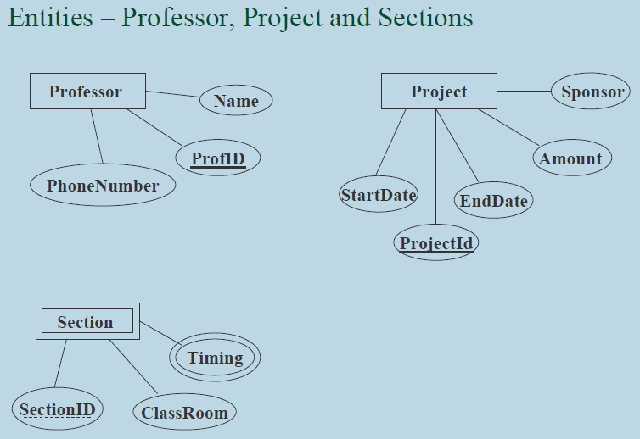
ER Diagram

Slide 39
Removing Redundant Attributes in Entity Sets
The entity set instructor includes the attributes ID, name, dept name, and salary,with ID forming the primary key.
• The entity set department includes the attributes dept name, building, and budget,with dept name forming the primary key.
Each instructor has an associated department using a relationshipset inst dept relating instructor and department.
The attribute dept name appears in both entity sets. Since it is the primary key for the entity set department, it is redundant in the entity set instructor and needs to be removed.

Slide 40
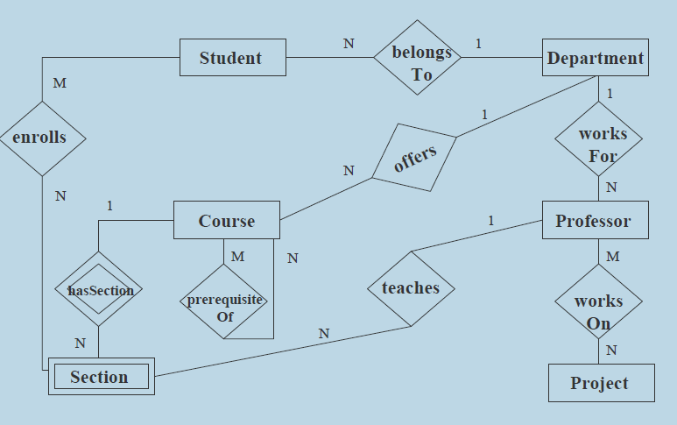
Example of an ER Diagram

Slide 41
Construct an ER diagram for a University Database. Assume the nature and functionality identify appropriate entity and relationship sets and build an ER model for the same.

Slide 42
A good entity-relationship design does not contain redundant attributes. For our university example, we list the entity sets and their attributes below, with primary keys underlined:
classroom: with attributes (building, room number, capacity)
department: with attributes (dept name, building, budget)
course: with attributes (course id, title, credits)
instructor: with attributes (ID, name, salary)
section: with attributes (course id, sec id, semester, year)
student: with attributes (ID, name, tot cred)
time slot: with attributes (time slot id, {(day, start time, end time) })

Slide 43
The relationship sets in our design are listed below:
inst dept: relating instructors with departments.
stud dept: relating students with departments
teaches: relating instructors with sections.
takes: relating students with sections, with a descriptive attribute grade.
course dept: relating courses with departments.
sec course: relating sections with courses.
sec class: relating sections with classrooms.
sec time slot: relating sections with time slots.
advisor: relating students with instructors.
prereq: relating courses with prerequisite courses.

Slide 44
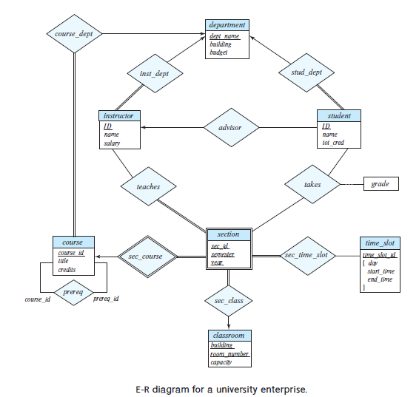

Slide 45
Exercise :
Construct an E-R diagram for a car insurance company whose customers own one or more cars each. Each car has associated with it zero to any number of recorded accidents. Each insurance policy covers one or more cars and has one or more premium payments associated with it. Each payment is for a particular period of time, and has an associated due date, and the date when the payment was received.

